Slide 1
Debug for IVT
Using debug to determine interrupt vector addresses
CS2650 – © Rob Hilton

Slide 2
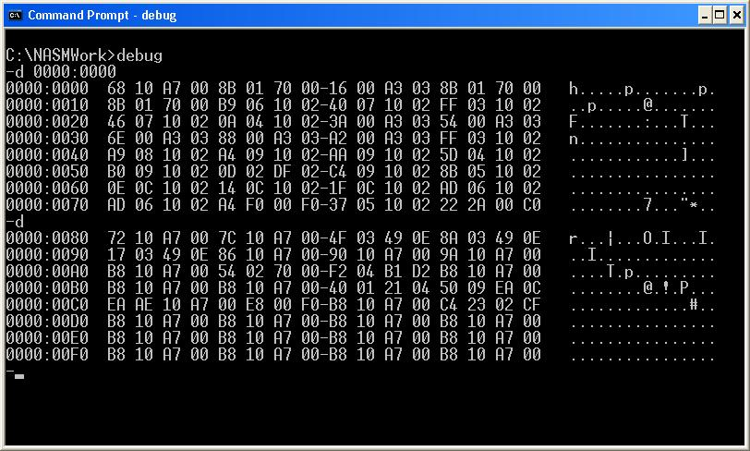
Debug 1
DOS debug is a simple hex editor program. It comes with all versions of Windows.
You run debug by opening a DOS command window and typing debug at the dos prompt
CS2650 – © Rob Hilton

Slide 3
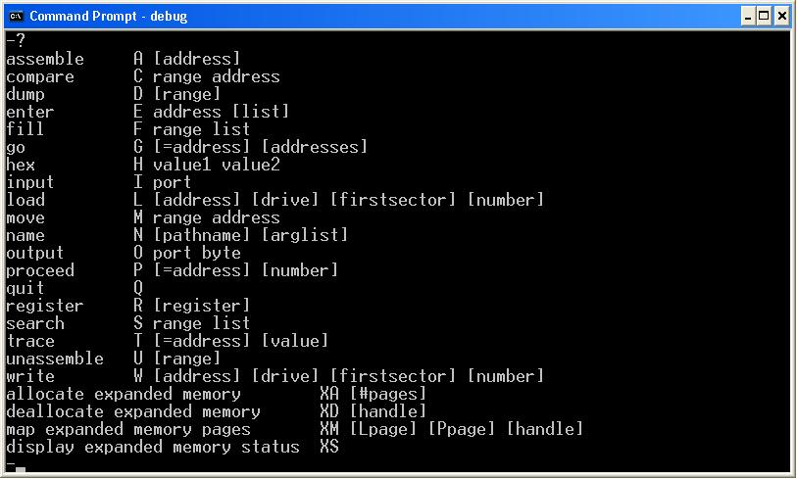
Debug 2
You can get a list of all of the available debug commands at any time by typing ? at the debug prompt.
CS2650 – © Rob Hilton

Slide 4
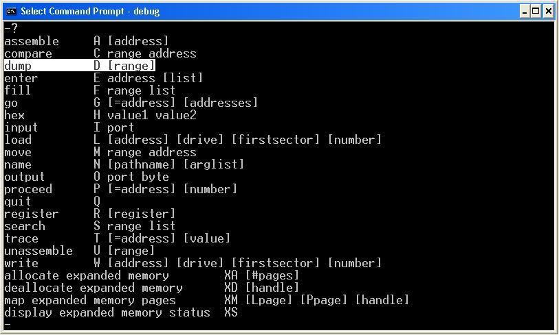
Debug 3
For this section of the class, you’ll mostly be interested in the dump command, which displays the contents of a specified memory range.
CS2650 – © Rob Hilton

Slide 5
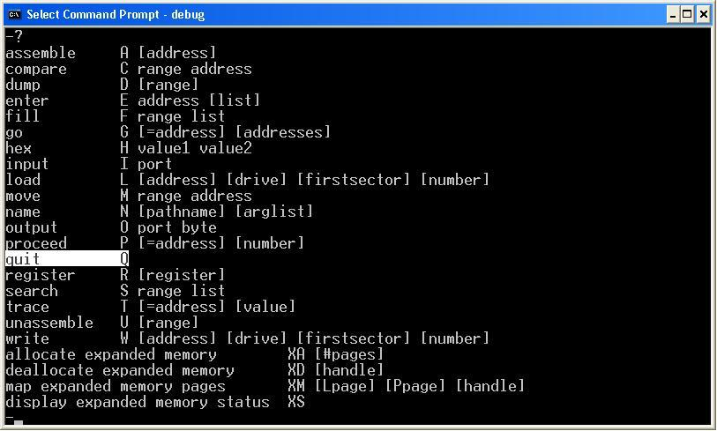
Debug 4
And the quit command to exit the debug program
CS2650 – © Rob Hilton

Slide 6
Debug 5
If you use the d command to display the contents of the memory at segment 0000 and offset 0000, the beginning of the interrupt vector table (IVT) is displayed.
CS2650 – © Rob Hilton

Slide 7
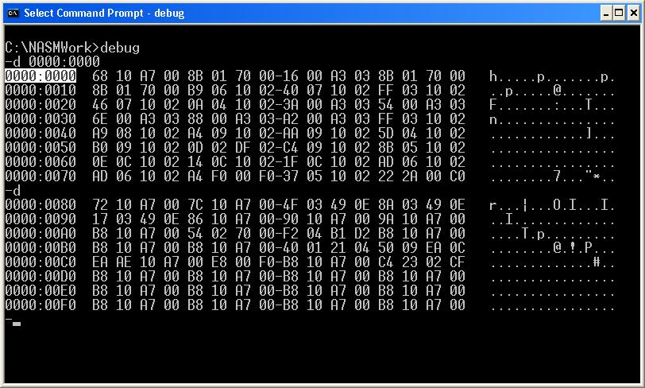
Debug 6
The debug dump display shows the contents of a range of memory. At the left of the display is the address (in hex) of the beginning of that row.
CS2650 – © Rob Hilton

Slide 8
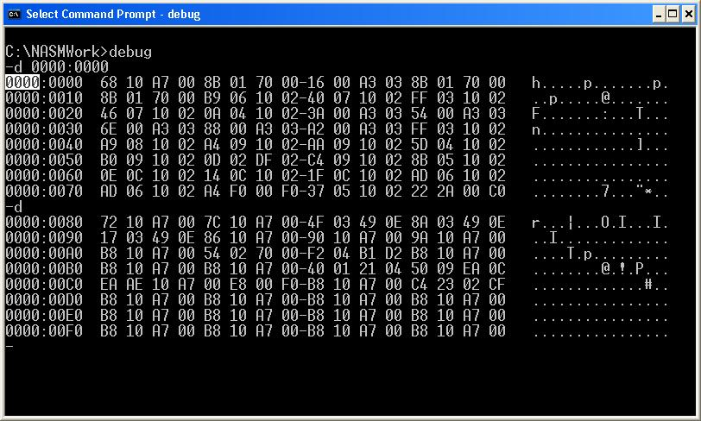
Debug 7
The addresses are in segment:offset format. The first 4 hex digits are the memory segment.
CS2650 – © Rob Hilton

Slide 9
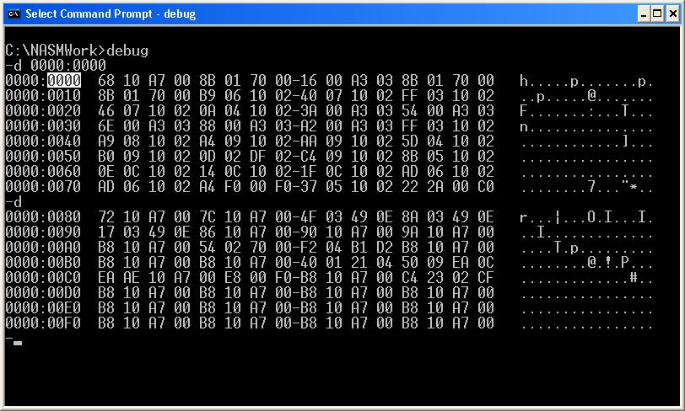
Debug 8
The four digits following the colon separator are the offset portion of the address. Note that the offsets increment in 16’s (hex) because each row of the display has 16 bytes being displayed.
CS2650 – © Rob Hilton

Slide 10
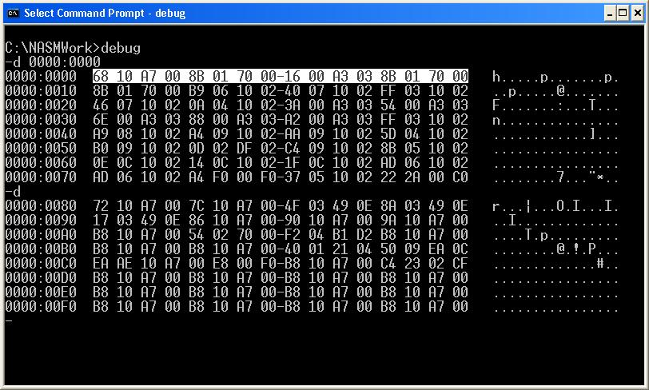
Debug 9
Each of the lines display 16 bytes in hex format. Each byte is separated by a space. The first eight bytes are separated from the last eight bytes by a hyphen.
CS2650 – © Rob Hilton

Slide 11
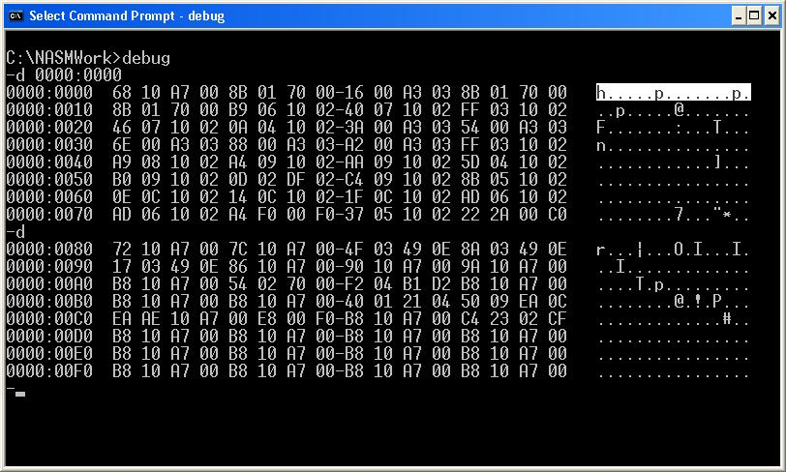
Debug 10
At the right of the display, the ASCII representation of the sixteen bytes on the row is displayed. If a byte is non-displayable, a period is shown to maintain place. For example, in this display, the first byte of the first row is 68h, that translates to a lower case h. The next byte is 10h, but since that’s a non-displayable character, a period is shown instead.
CS2650 – © Rob Hilton

Slide 12
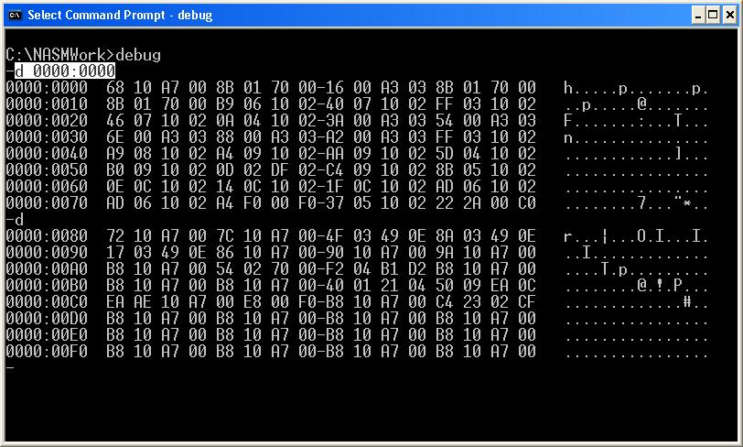
Debug 11
The d 0000:0000 command displays the memory located at segment zero, offset zero of the DOS RAM. This is the interrupt vector table of the PC. It contains 256 addresses, in 16-bit segment offset format. Each row of the display contains four addresses. Each address points to a program in memory that will process the corresponding interrupt.
CS2650 – © Rob Hilton

Slide 13
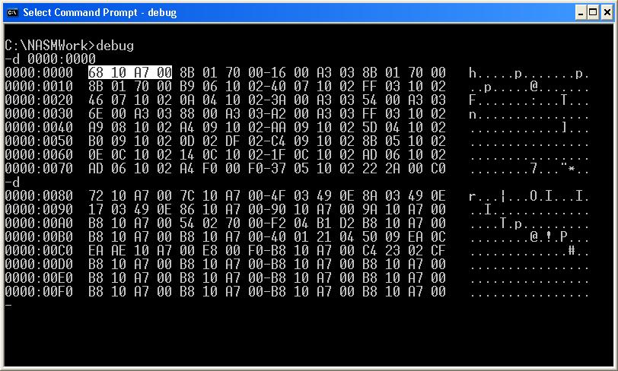
Debug 12
Each interrupt address is four bytes long, stored in little-endian (reverse) format.
The first address corresponds to INT 00h
CS2650 – © Rob Hilton

Slide 14
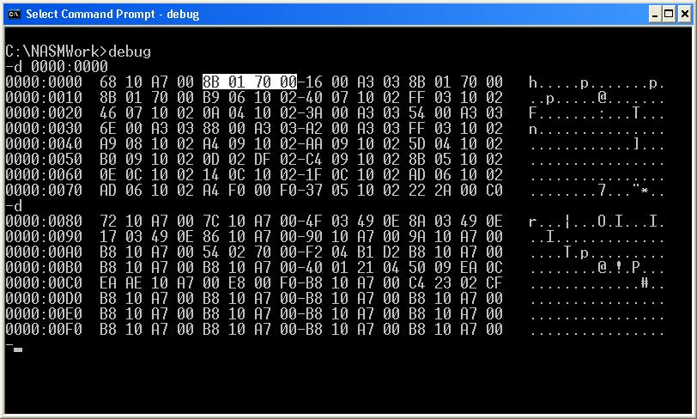
Debug 13
The second to interrupt 01h
CS2650 – © Rob Hilton

Slide 15
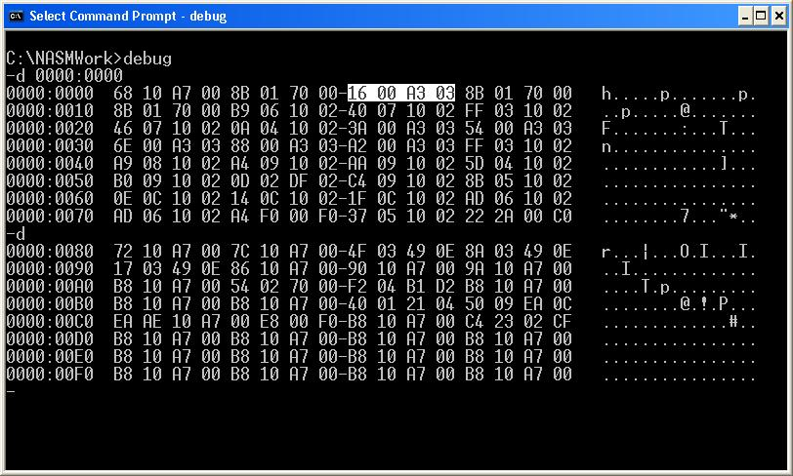
Debug 14
The third to interrupt 02h
CS2650 – © Rob Hilton

Slide 16
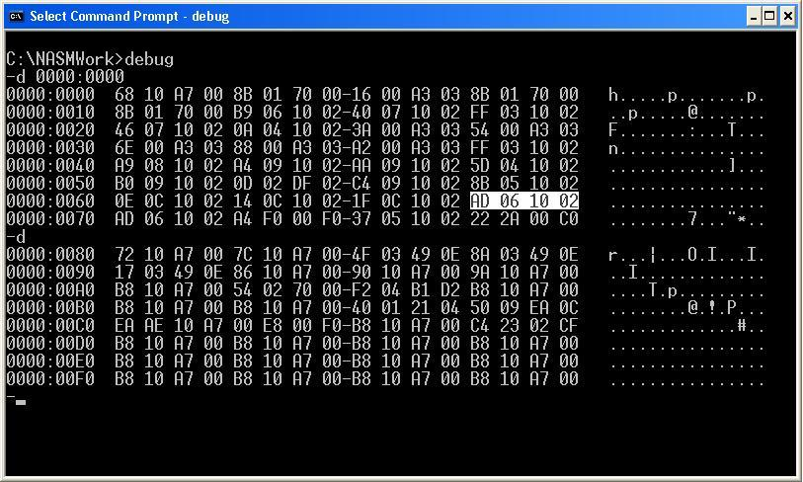
Debug 15
This interrupt corresponds to interrupt 1Bh.
CS2650 – © Rob Hilton

Slide 17
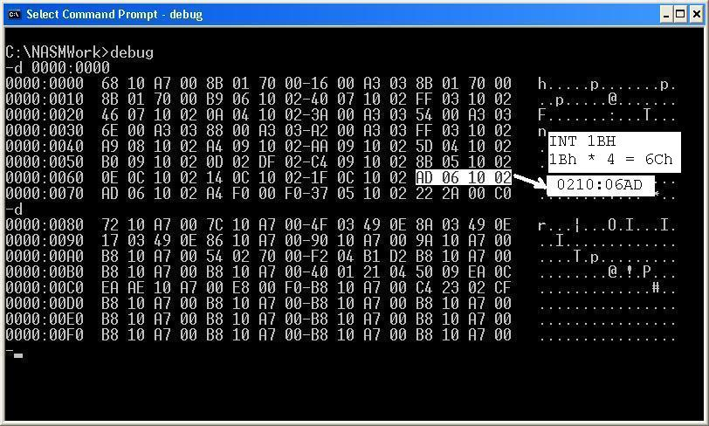
Debug 16
Since each address is four bytes long, you can calculate the location of an address by multiplying the interrupt number by 4 using hex multiplication. If you multiply the interrupt 1Bh by 4, the answer is 6Ch.
CS2650 – © Rob Hilton

Slide 18
Debug 17
To locate the address at 6Ch, you go to the row of the display that starts with 60h and go over to the 13th byte on the row, since the row addressing starts at zero.
CS2650 – © Rob Hilton

Slide 19
Debug 18
Beginning at the offset address of 6Ch, you select the four bytes of the address.
Then take each byte in reverse order. After you have reversed the bytes of the address, you take the first four to be the segment part of the address and the next four to be the offset.
CS2650 – © Rob Hilton

